Slide 1
Case Discussion
INFO 4940/5940:
U.S. Copyright Law
Mike Priehs – February 12, 2025

Slide 2
Agenda
01
03
02
04
Review
Turner v. Huston
Topics from this week
“The Asphalt Jungle”
Fairness Theory
Castillo v. G&M Realty
Examples
5Pointz

Slide 3
01
Review

Slide 4
Topics this Week
Multilateral Treaties
  Berne Convention
  TRIPS
  WIPO
Fairness Theory
  Most similar to U.S. copyright system
Personality Theory
  Moral Rights

Slide 5
02
Fairness Theory
More to come…

Slide 6
Fairness Theory Cases
Fair Use
Perfect 10 v. Google
Parody / Covers
News Reporting

Slide 7
03
Turner v. Huston
Court of Appeals of Versailles, France (1994)

Slide 8
Case Background
Film: "The Asphalt Jungle" (1950)
Director: John Huston
Production Company: Metro-Goldwyn-Mayer (MGM)
Owner of Rights: Turner Entertainment Co. (after acquiring MGM's film library)
Notes:
Mark Towle owned Gotham Garage in Temecula, CA. Featured on a Netflix show called “Car Masters: Rust to Riches” in 2018.

Slide 9
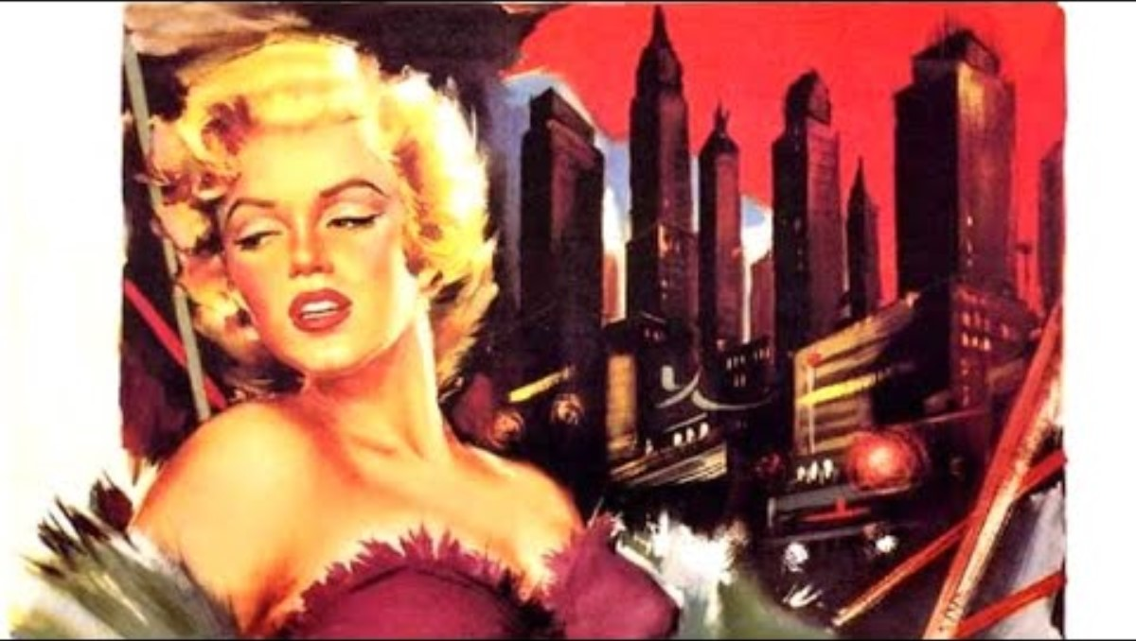

Slide 10
Plaintiff
Turner Entertainment Co.
A subsidiary of Warner Bros. Discovery, known for owning and distributing a vast library of classic films and television shows. Owns the rights to the John Huston film, “The Asphalt Jungle.”
Objective: Colorize "The Asphalt Jungle" for modern audiences
Justification: Ownership of the film's rights allows modification
Argument: Colorization can increase the film's commercial appeal and accessibility

Slide 11
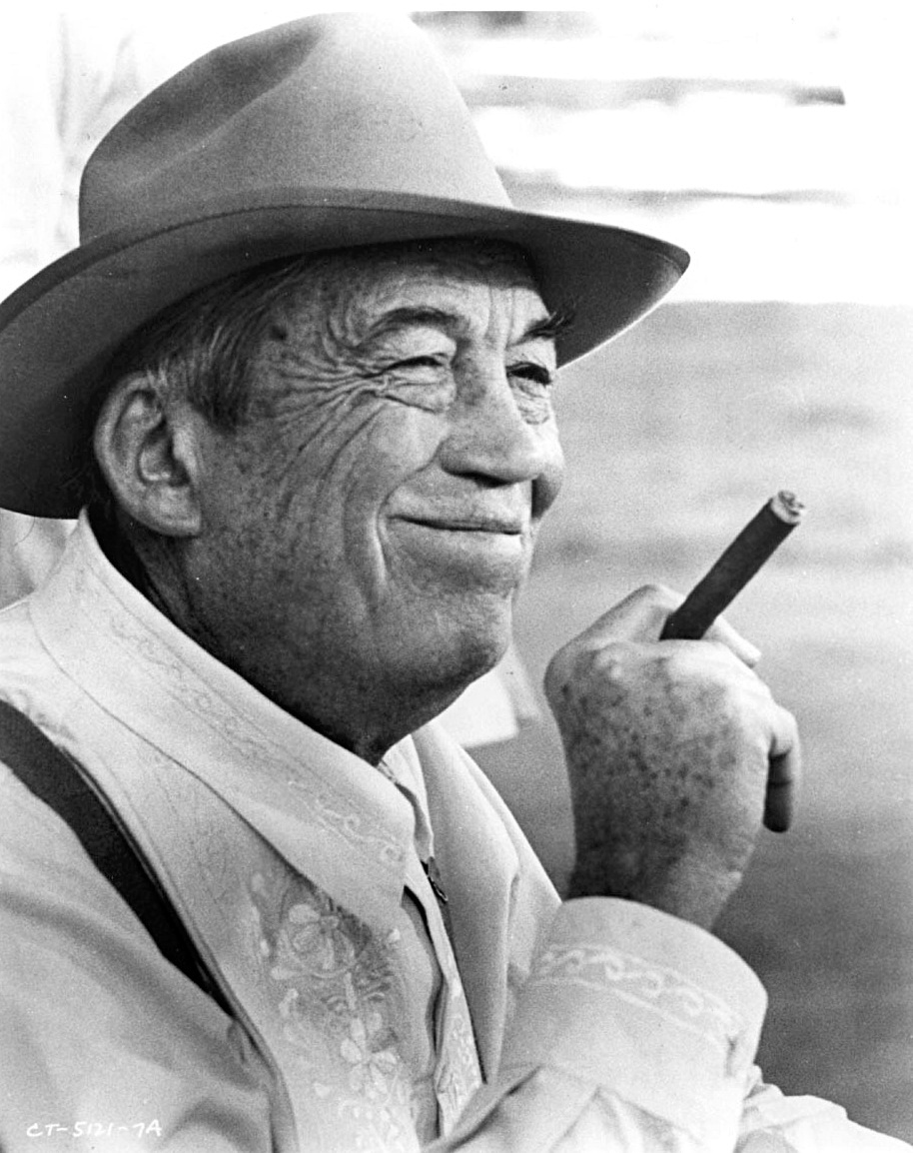
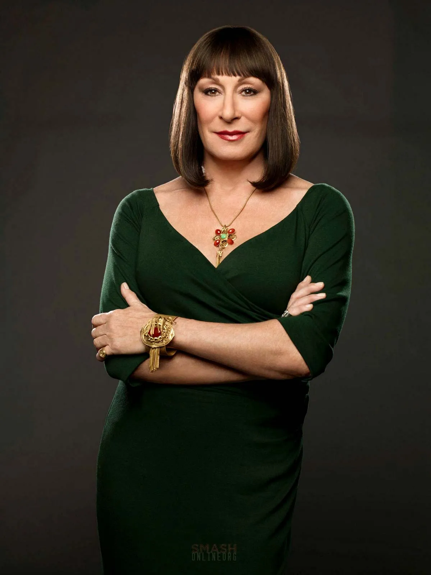
Defendant
John Huston’s heirs
John Huston was a celebrated American filmmaker, screenwriter, and actor. Directed classic films like “The Maltese Falcon” and “The Treasure of the Sierra Madre.”
Objective: Prevent colorization of the film
Justification: Protecting the director's original artistic vision
Argument: Colorization violates the moral rights of the author and alters the work's intended aesthetic

Slide 12
Legal Action
Initiator: Turner Entertainment Co. decided to colorize the film
Opposition: Huston's heirs opposed the colorization, citing moral rights of the author
Court: French courts were involved due to the international broadcast of the film

Slide 13
Decision & Significance
Court’s Decision:
Found in favor of John Huston’s heirs
Recognized the moral rights of the author
Prohibited the broadcast of the colorized version of “The Asphalt Jungle” on television
Significance of the Case:
Moral Rights: Reinforced the concept of moral rights in copyright law, protecting the reputation and integrity of an author’s work
Artistic Integrity: Emphasized the importance of preserving the original artistic vision of creators
Precedent: Set a legal precedent for future disputes involving alterations to original works

Slide 14
04
Castillo v. G&M Realty L.P.
U.S. Court of Appeals for the Second Circuit, 950 F.3d 155 (2020)

Slide 15
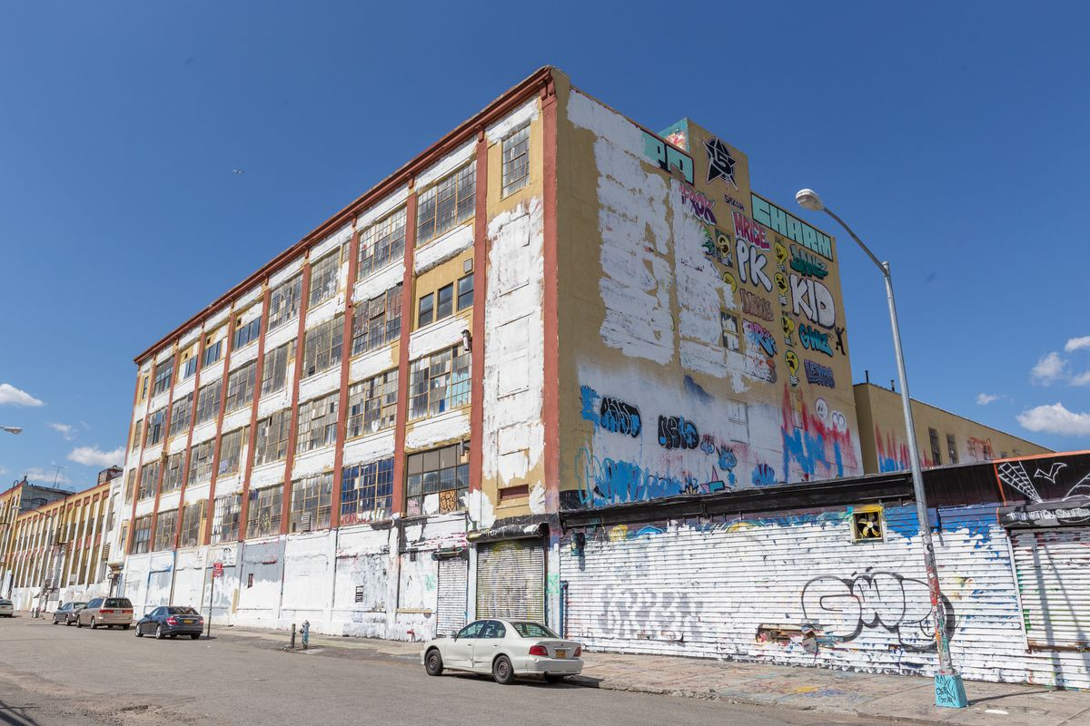
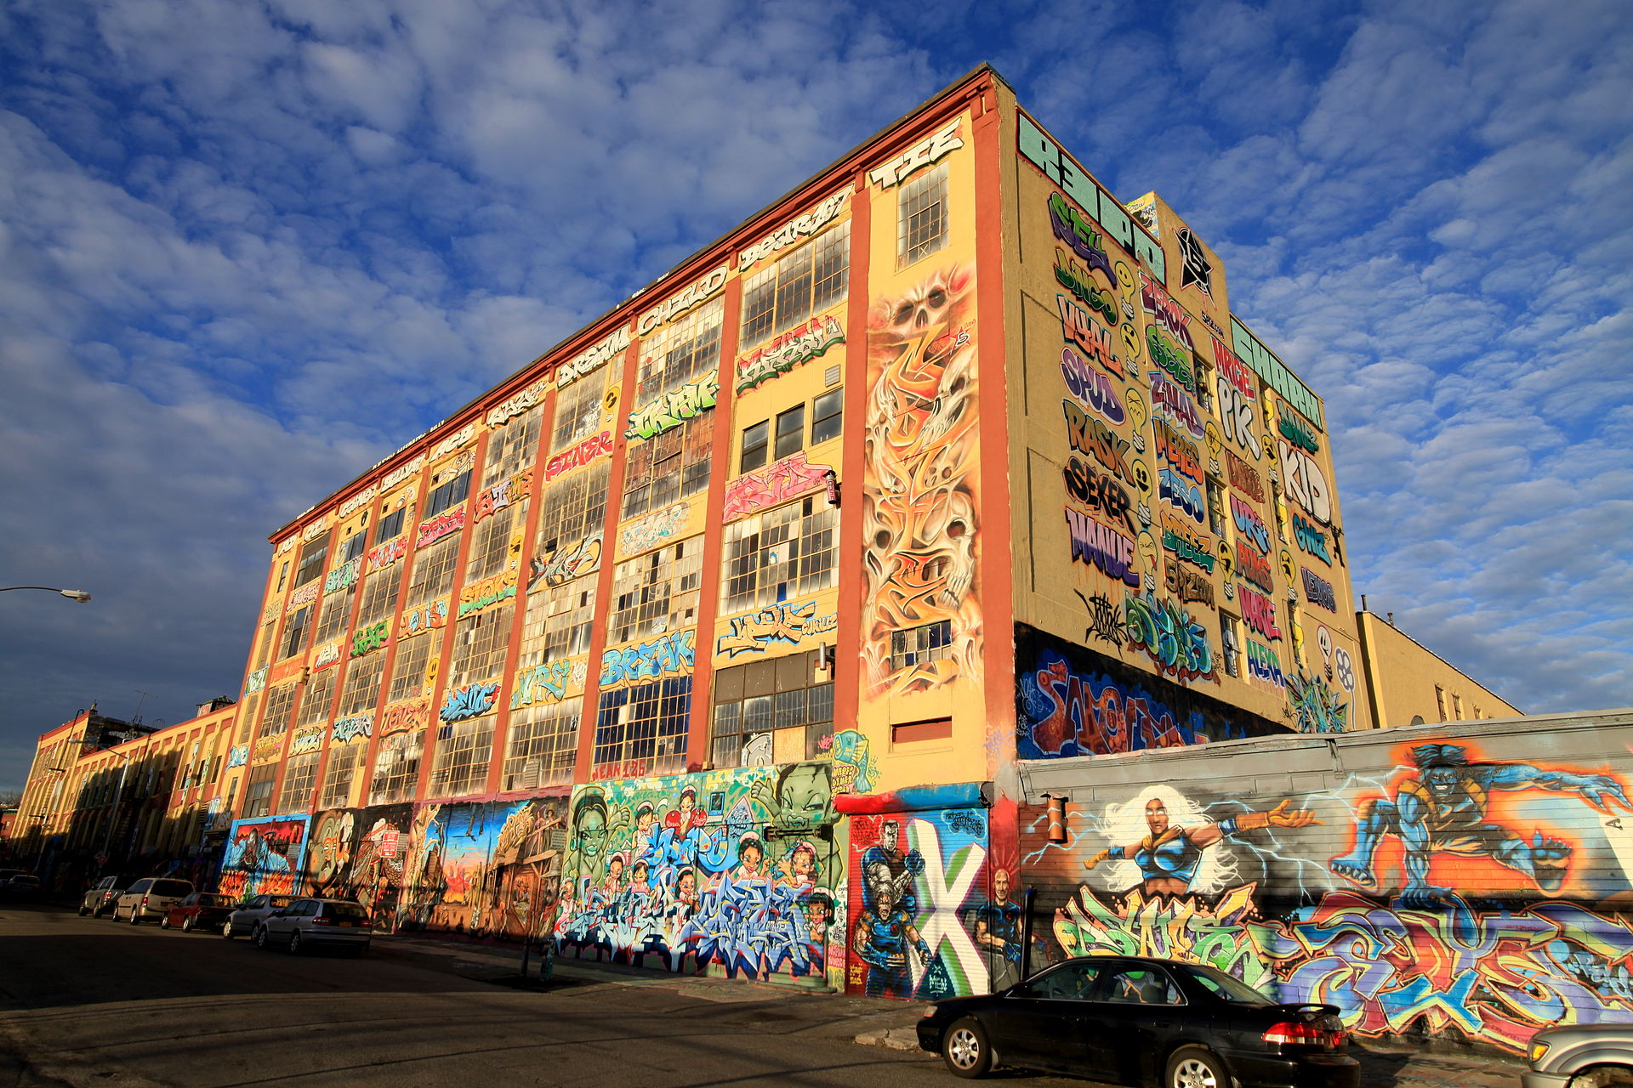
Case Background
Site: 5Pointz, Long Island City, Queens, New York
Owner: Gerald Wolkoff
Art Form: Aerosol art (graffiti)
Artists: Led by Jonathan Cohen
Issue: Wolkoff whitewashed the murals overnight in preparation to demolish the building

Slide 16
Plaintiffs
Maria Castillo and other artists
Objective: Prevent the demolition of 5Pointz and the destruction of their art
Justification: Protection of their artwork under the Visual Artists Rights Act (VARA)
Argument: The destruction of their art violated their moral rights as creators

Slide 17
Defendants
G&M Realty, L.P. and Gerald Wolkoff
Objective: Demolish the 5Pointz building for redevelopment
Justification: Ownership of the property allows for modification and demolition
Argument: The artwork was temporary and should not hinder property development plans

Slide 18
Visual Artists Rights Act of 1990
VARA exclusively grants authors of works that fall under the protection of the Act the following rights:
right to claim authorship
right to prevent the use of one's name on any work the author did not create
right to prevent use of one's name on any work that has been distorted, mutilated, or modified in a way that would be prejudicial to the author's honor or reputation
right to prevent distortion, mutilation, or modification that would prejudice the author's honor or reputation

Slide 19
Decision & Significance
Court’s Decision:
Court sided with the artists
Recognized the moral rights of the artists under VARA
Awarded statutory damages to the artists for the willful destruction of their works
Significance of the Case:
Moral Rights: Reinforced the concept of moral rights in copyright law, protecting the reputation and integrity of an author’s work
Notably, the only “moral rights” under U.S. copyright law
Artistic Integrity upheld
Precedent set

Slide 20
Questions?
Thanks!

